Slide 1



Loot Box Pricing and Design
Presenter: Michael L. Hamilton
Joint w/: Ningyuan Chen, Adam N. Elmachtoub, and Xiao Lei
POMS 2021
Department of IEOR
Data Science Institute

Slide 2
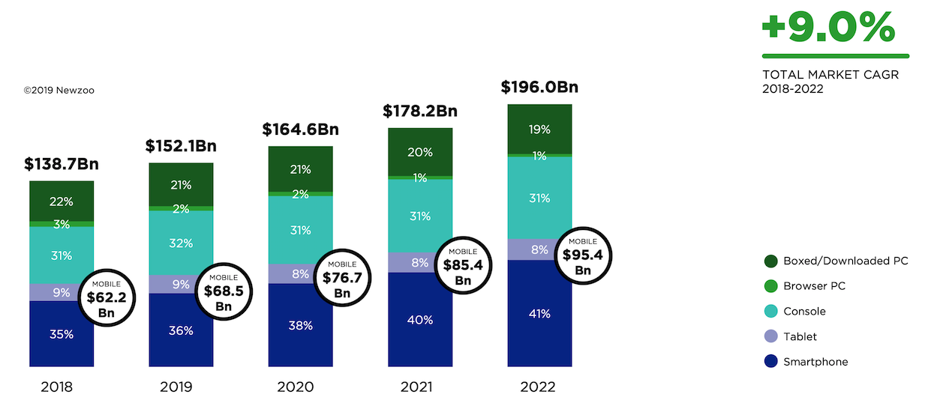

The Video Game Industry
The video game industry is booming
Revenue in the Ride Hailing segment amounts to $183.7Bn in 2019.

Slide 3
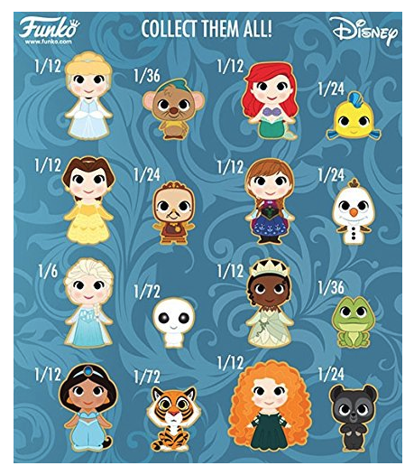
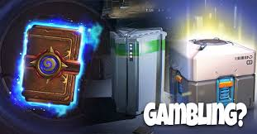
Loot Boxes in Practice
A loot box is a random allocation of virtual items whose contents are not revealed until after purchase.
An increasingly common practice in online video games
More than $30 billion dollars in sales via loot boxes in ’18 [Wright, 18]

Slide 4
Loot Boxes in Practice
A loot box is a random allocation of virtual items whose contents are not revealed until after purchase.
An increasingly common practice in online video games
More than $30 billion dollars in sales via loot boxes in ’18 [Wright, 18]
Example:
Game - Rocket League
Desc. - The Crate - Totally Awesome is a loot box containing 8 virtual items
Price - $1.49 per loot box

Slide 5
Loot Boxes in Practice
A loot box is a random allocation of virtual items whose contents are not revealed until after purchase.
An increasingly common practice in online video games
More than $30 billion dollars in sales via loot boxes in ’18 [Wright, 18]
While profitable, loot boxes are quite controversial in practice.
The transparency of the contents, and probability outcomes of loot boxes, can be misrepresented by an unscrupulous seller [Fingas, ‘18]
Emerging research in psychology have linked loot boxes with gambling [Zandle & Cairns, ‘18]
Many governments have begun exploring regulatory policy
FTC held a workshop in Aug. ‘19

Slide 6
Contributions
Research Questions
Q1: Why do video game companies use loot boxes instead of common deterministic selling strategies, e.g., bundling and separate selling?
We show loot box selling outperforms standard selling paradigms like separate selling or bundling selling in a natural model.
Q2: How should a seller design and price loot boxes?
We identify a natural, critical feature of loot boxes that allows sellers to leverage the online marketplace to maximize their revenue. We also characterize the optimal price, and consider numerous extensions
Q3: What is the impact of loot boxes on consumers
We consider the social welfare in the market with loot boxes. We show for some variants of loot box selling, a salvage system (resale market) can allow loot box sellers to smoothly trade-off rev. with soc. welfare
Notes:
We consider a more realistic version of personalized pricing we term feature-based
pricing, and show how to transform our previous bounds into bounds on the value of
feature-based pricing over single price strategies (cf. Lemma 9 and Theorem 5) via a
novel extension theorem. These bounds makes explicit the relationship between the
accuracy of a sellers prediction model, and value of personalized pricing in a market.

Slide 7
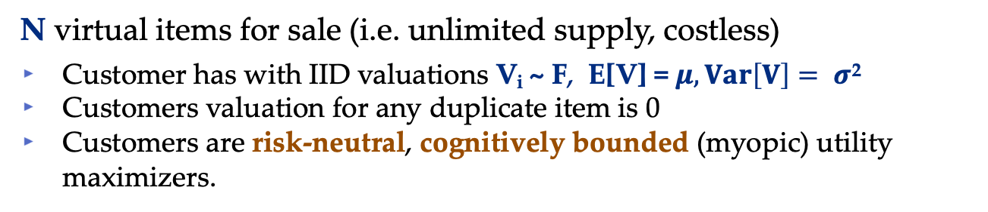
Framework
N virtual items for sale (i.e. unlimited supply, costless)
Customer has with IID valuations V_{i} ~ F, E[V] = $μ, Var\left[V\right]= σ$²
Customers valuation for any duplicate item is 0
Customers are risk-neutral, cognitively bounded (myopic) utility maximizers.
Each loot box is for sale for a fixed price p
Suppose each loot box will output just a single item from the set of N
Extensions to multi-item box in paper
At each period t, customer has inventory S_{t} ⊆ [N]
A unique (loot) box is aware of S_{t} and always allocates a item in S_{t}\[N]
A traditional (loot) box ignores S_{t} and allocates items unif. at rand. in S_{t}

Slide 8
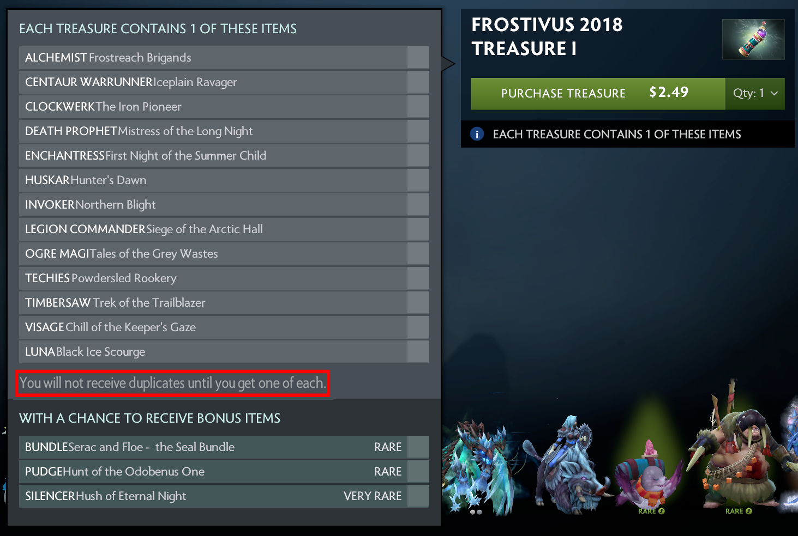
Unique vs Traditional Boxes
Both unique and traditional loot boxes are common in practice
A unique box from DOTA 2
A traditional box from Rocket League
Unique boxes allocate items without replacement
Unique boxes allocate items with replacement

Slide 9


Example (Traditional Box)
$6, $2, $7
$1, $9, $2
($6+$2+$7+$1+$9+$2)/6=$4.5>$2.99
1
$2.99
Cumulative Revenue | Cumulative Surplus
0 | 0

Slide 10

Example (Traditional Box)
$6, $2, $7
$1, $9, $2
1
$2.99
Cumulative Revenue | Cumulative Surplus
$2.99 | $6.01

Slide 11
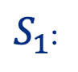
Example (Traditional Box)
$6, $2, $7
$1, $0, $2
($6+$2+$7+$1+$0+$2)/6=$3>$2.99
2
$2.99
Cumulative Revenue | Cumulative Surplus
$2.99 | $6.01
$S_{1}$:

Slide 12
Example (Traditional Box)
$6, $2, $7
$1, $0, $2
2
$2.99
Cumulative Revenue | Cumulative Surplus
$5.98 | $3.02
$S_{1}$:

Slide 13
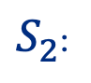
Example (Traditional Box)
$6, $2, $7
$1, $0, $2
($6+$2+$7+$1+$0+$2)/6=$3>$2.99
3
$2.99
Cumulative Revenue | Cumulative Surplus
$5.98 | $3.02
$S_{2}$:

Slide 14
Example (Traditional Box)
$6, $2, $7
$1, $0, $2
3
2.99 $
Cumulative Revenue | Cumulative Surplus
$8.97 | $6.03
$S_{2}$:

Slide 15
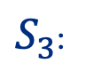
Example (Traditional Box)
$0, $2, $7
$1, $0, $2
($0+$2+$7+$1+$0+$2)/6=$2<$2.99
4
$2.99
Cumulative Revenue | Cumulative Surplus
$8.97 | $6.03
$S_{3}$:

Slide 16
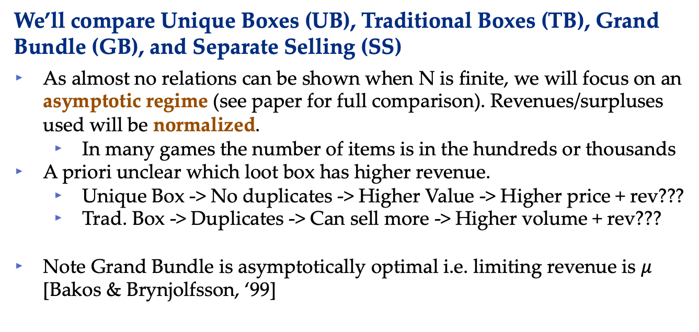
Q1: Why are loot boxes so popular?
Two benchmark sales strategies
Grand Bundle (Selling) where are the N items are sold together at one (large) common price.
Separate Selling where the N items are sold separately each a retail price
We’ll compare Unique Boxes (UB), Traditional Boxes (TB), Grand Bundle (GB), and Separate Selling (SS)
As almost no relations can be shown when N is finite, we will focus on an asymptotic regime (see paper for full comparison). Revenues/surpluses used will be normalized.
In many games the number of items is in the hundreds or thousands
A priori unclear which loot box has higher revenue.
Unique Box -> No duplicates -> Higher Value -> Higher price + rev???
Trad. Box -> Duplicates -> Can sell more -> Higher volume + rev???
Note Grand Bundle is asymptotically optimal i.e. limiting revenue is $μ$ [Bakos & Brynjolfsson, ‘99]

Slide 17
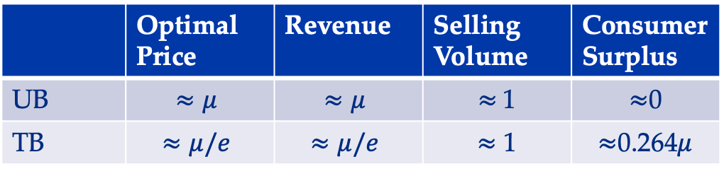
Q1: Theoretical Results
Theorems [UB is optimal, TB is sub-optimal].
For IID valuations, and as N tends to infinity:
 | Optimal Price | Revenue | Selling Volume | Consumer Surplus
UB | $$≈μ$$ | $$≈μ$$ | $≈$1 | $≈$0
TB | $$≈μ/e$$ | $$≈μ/e$$ | $≈$ 1 | $≈$0.264$μ$
Insights for Seller
Knowing customer inventory can increase rev from 37% to 100%
UB is asymptotically optimal just like GB, but without requiring customers to purchase everything upfront!
Insights for Customer
Average customer pays more for less surplus when UBs are used.

Slide 18
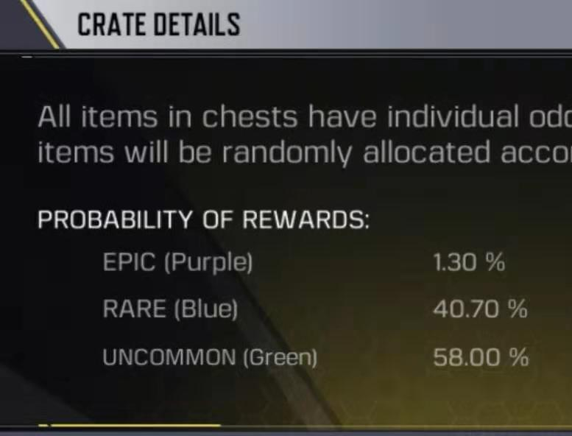
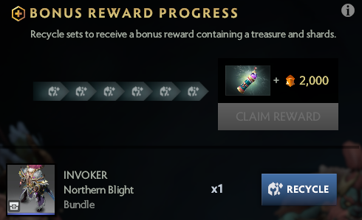
Q2: How to design and price boxes?
We consider a number of model extensions
Each loot box outputs multiple items (e.g. packs of cards).
We extend all previous results to this setting
Different classes of items so that valuations are not IID (e.g. common, rare, and legendary items)
We show uniform allocation rules are still optimal.
To increase consumer welfare sellers can implement a salvage system (resale market) where the customer can trade in duplicate/unwanted items
In this case UB and TB can both be guaranteed to outperform SS

Slide 19
Q3: Impact of Loot Boxes on Consumers?
What if sellers misrepresent allocation probabilities?
We construct an example where even small, balanced perturbations of the allocation probabilities can significantly increase a sellers revenue.
Our example holds even if the total allocation of items, across all customers, matches the announced probabilities!
Implies the need for strong regulation to ensure consumer protection

Slide 20
Key Takeaways
For Sellers
Unique loot boxes are asymptotically revenue optimal, even in the presence of budgets unlike TB (not optimal) or GB (fails with budgets).
For Consumers
Customers pay more and get less under unique loot boxes
This can be mitigated by a seller implementing a salvage system (resale market), which they can trade-off revenue and welfare.
For Regulators
Loot boxes are powerful revenue management mechanisms independent of the psychological effects.
Sellers have a profit incentive to misrepresent the allocation rules. Loot boxes must be carefully monitored to ensure fair outcomes.

Slide 21
Thank you!
Paper has appeared in Management Science
https://pubsonline.informs.org/doi/10.1287/mnsc.2020.3748
Direct link and slides available at https://mhamilton-pitt.github.io/
Contact: mhamilton@katz.pitt.edu

